Slide 1
Beyond Part Models: Person Retrieval with Refined Part Pooling(and A Strong Convolutional Baseline)
(ECCV2018)
Yifan Sun, LiangZheng, Yi Yang
Tsinghua University ,University of Technology Sydney

Slide 2
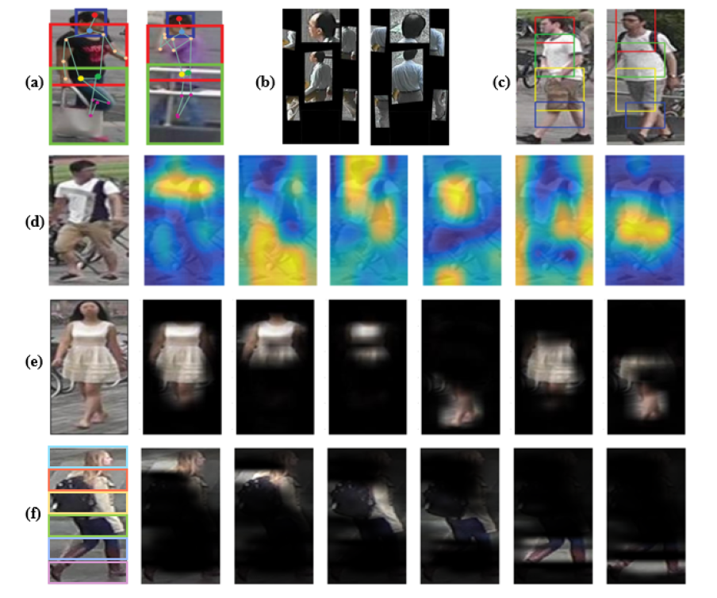

Slide 3
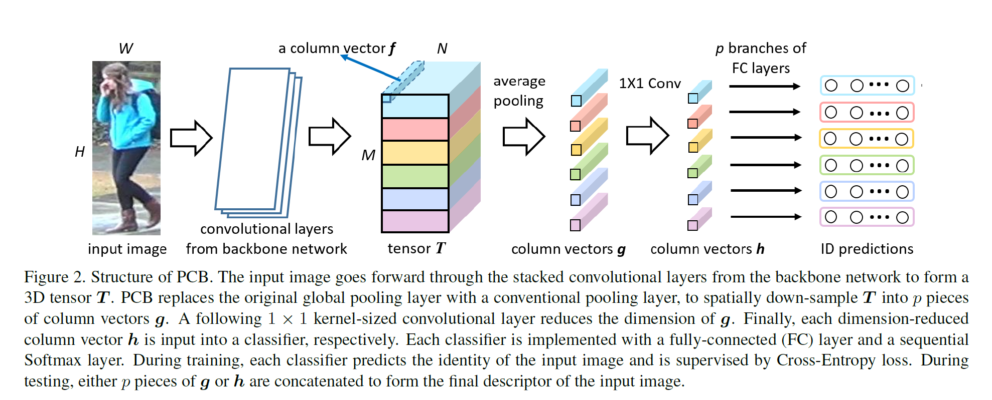

Slide 4
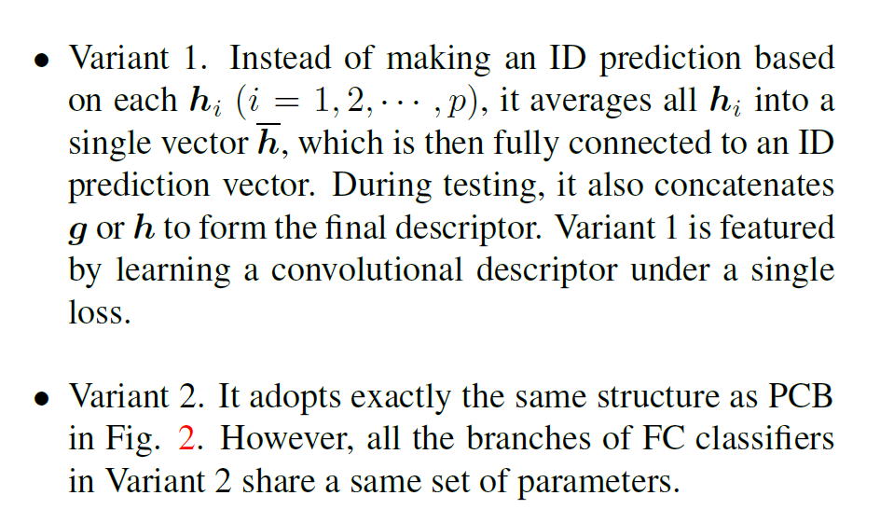

Slide 5
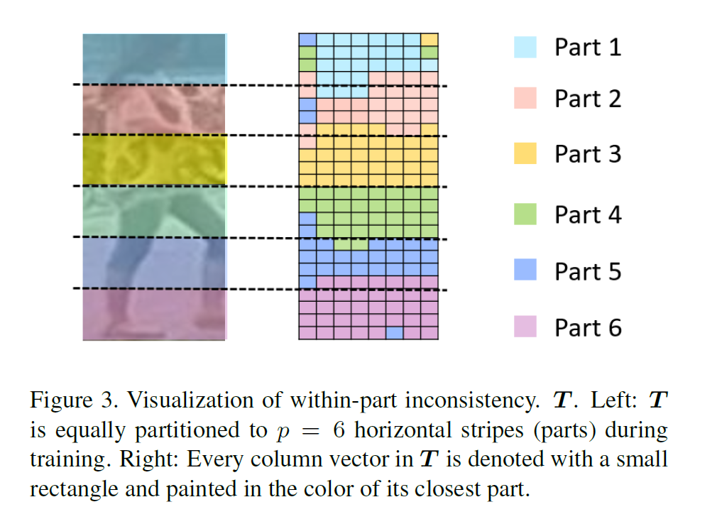

Slide 6
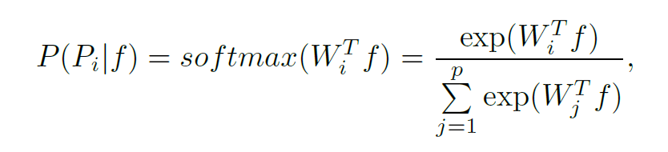
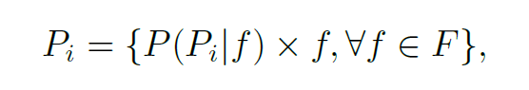

Slide 7
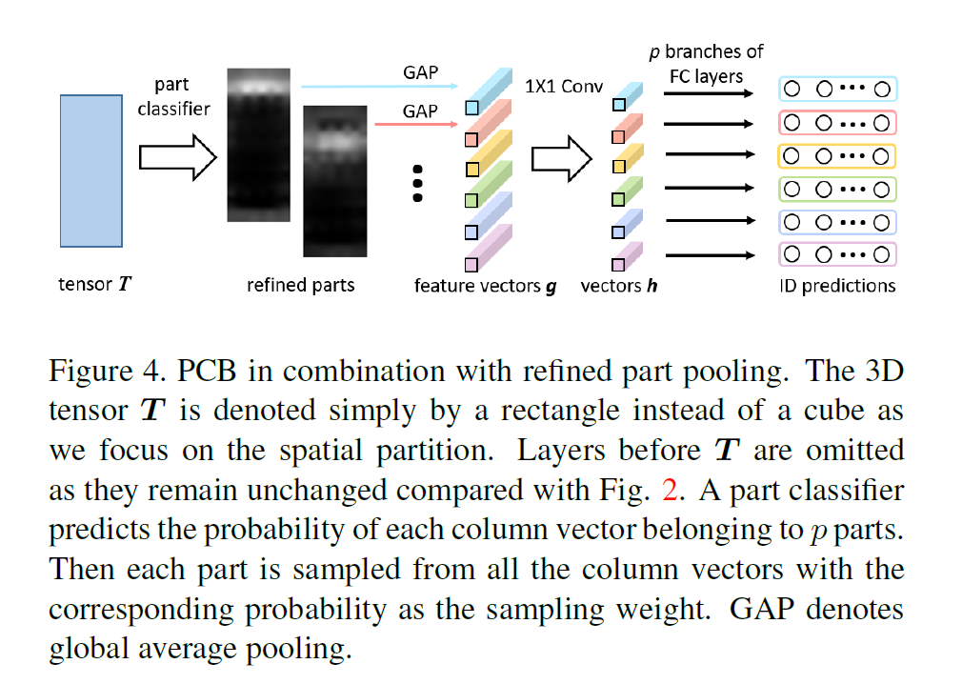

Slide 8
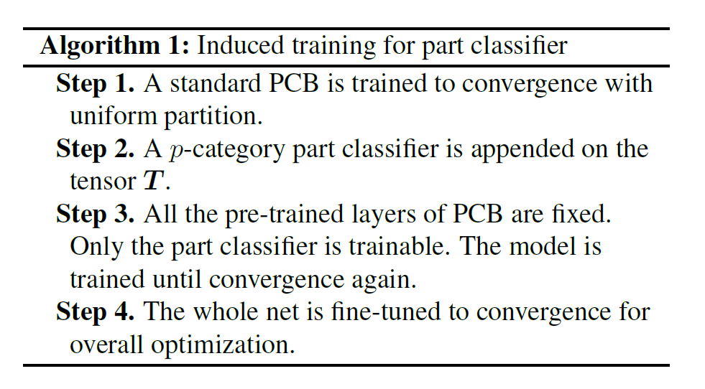

Slide 9
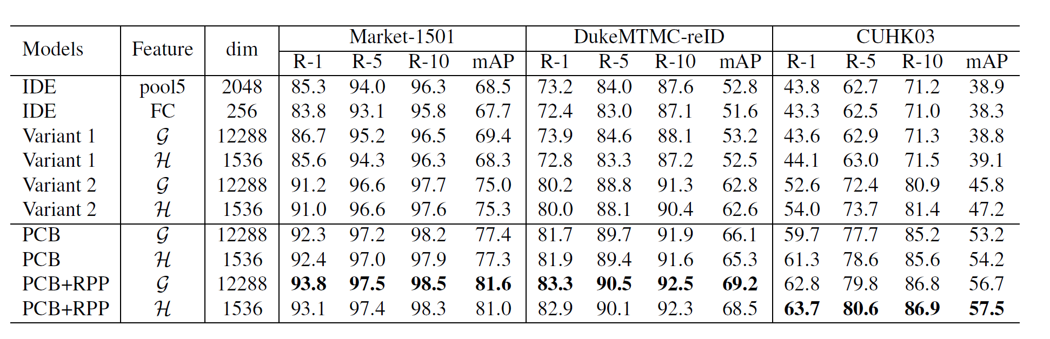

Slide 10
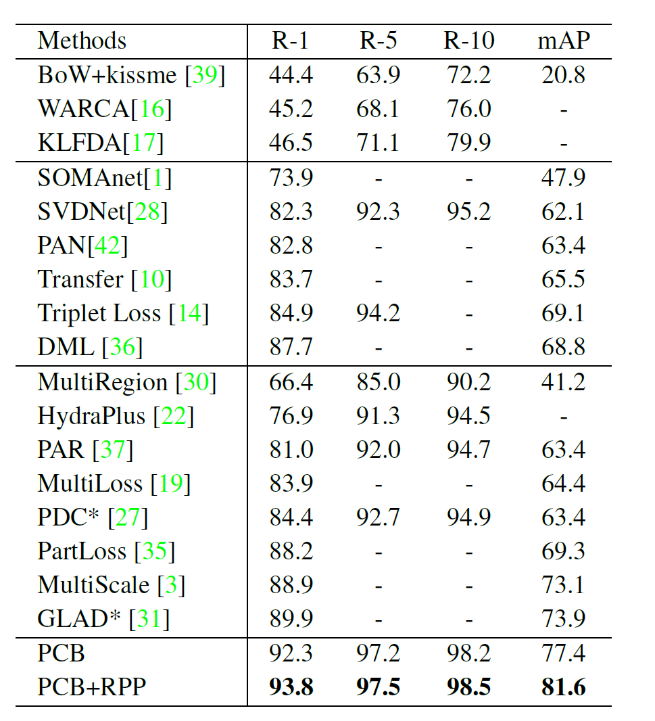
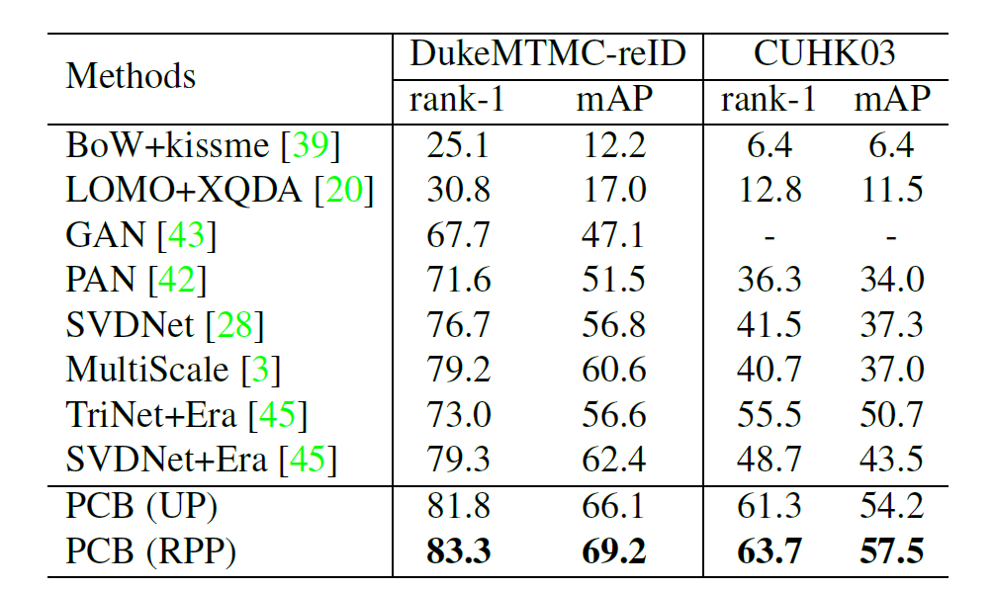

Slide 11
谢谢。

